Slide 1
The Battle of the Neighborhoods
Choosing best location for Retail Store in Delhi, India

Slide 2
Problem Description
Objective of this project is to find an optimal location for a retail store. Specifically, this report will be targeted to stakeholders interested in opening a retail store in Delhi, India.
Store location should be such that it attracts a lot of traffic all the time. A place where people likes to hang out, eat and chill is ideal place for retail stores. We would prefer locations to set up retail stores which has Indian Restaurant, Cafe and Pubs.

Slide 3
Data acquisition and cleaning
Details about Population, Literacy Rate and Sex Ratio of people living in each Tehsil of each District of Delhi is collected from the website of [Census India] https://www.censusindia.co.in/states/delhi
Details about postal codes of each tehsil, is collected from website: http://www.egreenwatch.nic.in/Masters/Public/TehsilView.aspx?SID=10
Foursquare API is used to get location coordinates of each tehsil/neighborhood, venues in the neighborhood of each Tehsil
All the unnecessary columns are dropped and all data frames are merged based on each neighborhood

Slide 4
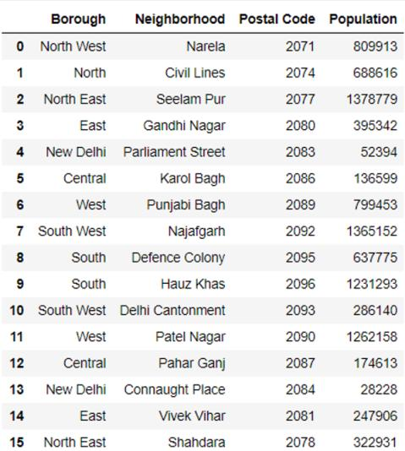
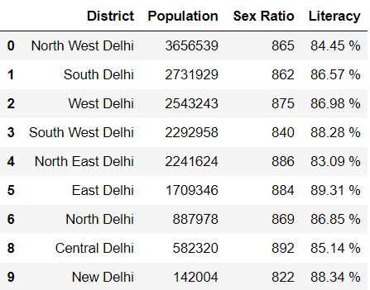

Slide 5
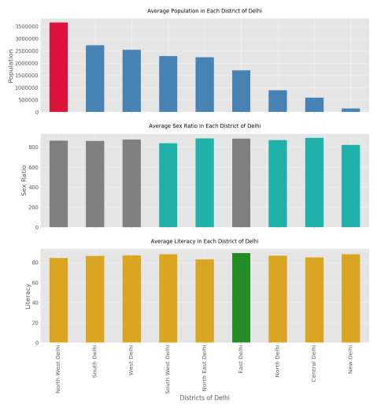
Exploring Population, Literacy Rate and Sex Ratio
Observations:
North West Delhi has highest population followed by South Delhi and then, West Delhi.
Central Delhi, East Delhi and North East Delhi have highest Sex Ratio
New Delhi has highest Literacy Rate followed by East Delhi

Slide 6
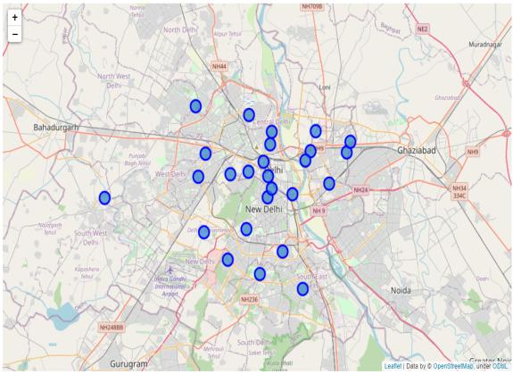
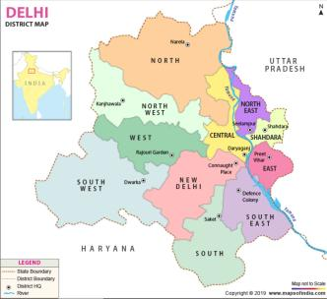
Visualizing Delhi on Map
After getting coordinate of each tehsil using geocoder library, we use folium maps to generate each tehsil/neighborhood of Delhi. Blue circle represents tehsil of Delhi

Slide 7
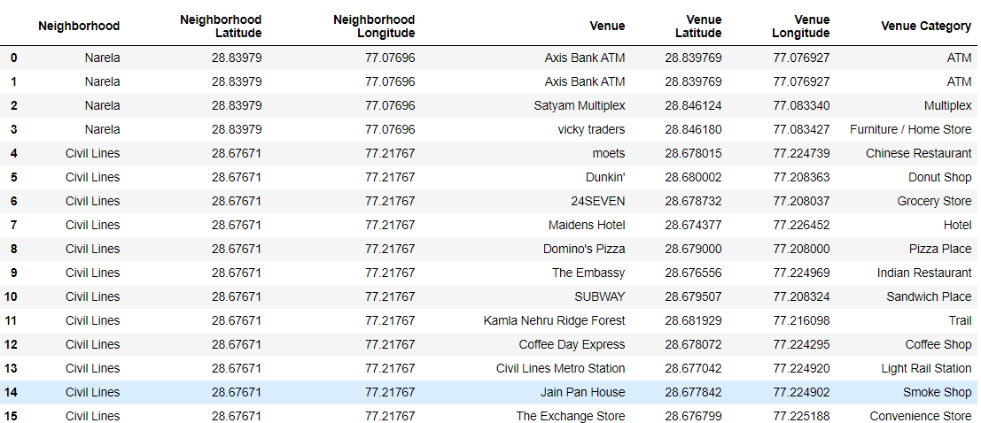
Exploring top 100 venues in each tehsil using Foursquare API to fetch venues in any tehsil
Exploring Venues in the Tehsils

Slide 8
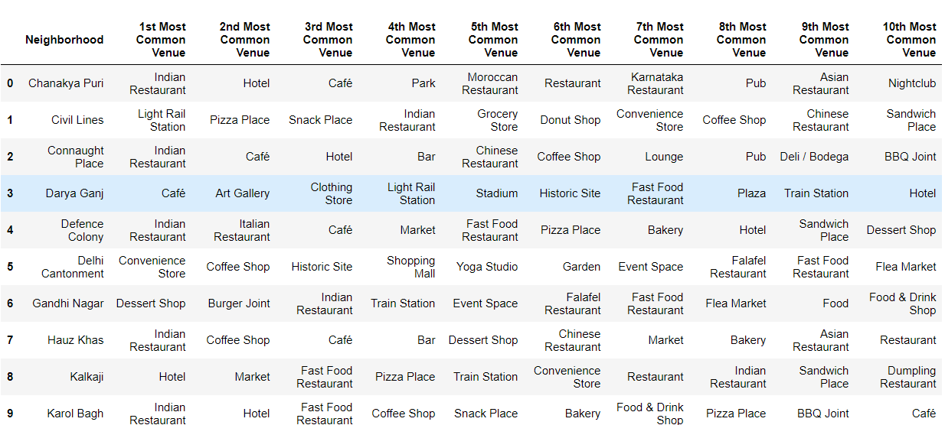
Data frame consisting of top 10 most common venues in each tehsil/neighborhood
Analyzing Each Neighborhood

Slide 9
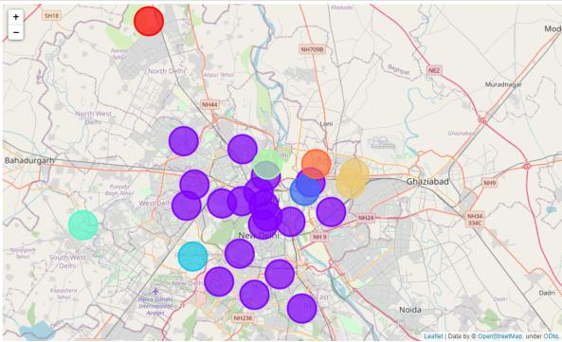
Using k means clustering algorithm, all tehsils are clustered based on unique venue category features. Total 8 clusters were created which further reduced to 6 based on some common values
Clustering Tehsils

Slide 10
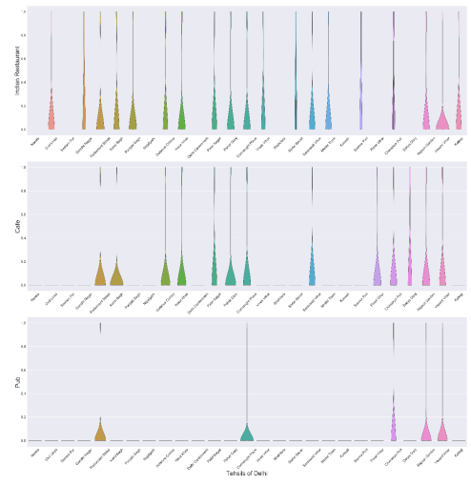
Finding and Visualizing Prospective Tehsils Based on a Criteria
Violin plot from the seaborn library is used to analyze venue data( visualize frequency distribution datasets, they display a density estimation of the underlying distribution)
Based on violin plots, Chanakya Puri, Connaught Place, Parliament Street, Vasant Vihar and Rajouri Garden can be considered for opening retail store.

Slide 11
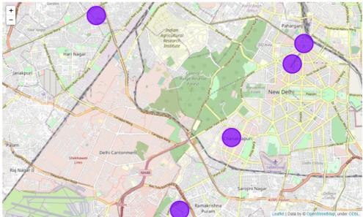
Results and Discussion
Based on above analysis we can say that West Delhi shows good potential for retail market as West Delhi has good population size, good literacy rate and descent gender ratio
we can narrow down our choice for prospective locations for a retail store to Rajouri Garden as it is in West Delhi District.(Red circle)

Slide 12
Conclusion
Analysis performed have some limitation which we can overcome by implementing following measures-
Area of each Tehsil can also be used for analysis.
Data related to centennials and millennials can be employed for decision-making and, thus can be used for further analysis.
Store Brands such as Shopper Stop, Reliance fresh, Big Bazaar etc. famous or trending in a particular tehsil can also be helpful to decide better locations for establishment of retail stores.

